Slide 1
APUSH Review: Key Concept 6.3, Revised
Everything You Need To Know About Key Concept 6.3 To Succeed In APUSH

Slide 2

Key Concept 6.3
“The Gilded Age produced new cultural and intellectual movements, public reform efforts, and political debates over economic and social policies.”
Page 65
Big Idea Questions:
What were different examples of discrimination that various groups faced in the late 19th century?
How did business leaders and the wealthy justify their wealth?
How did some in society criticize capitalism and what were the alternatives they proposed?

Slide 3
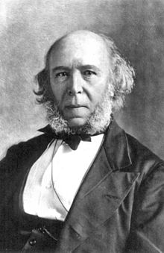
Key Concept 6.3, I
“New cultural and intellectual movements both buttressed (provided) and challenged the social order of the Gilded Age.” - page 65
A) Social Darwinism
What is it?
“Survival of the fittest”
Advocated for businesses to use any tactics to prosper
Why was it used?
To justify the success of the wealthy - appropriate and inevitable for the wealthy to succeed

Slide 4
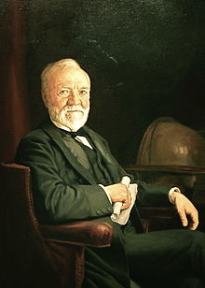
Key Concept 6.3, I
B) The Gospel of Wealth:
Written by Andrew Carnegie
Argued that the wealthy should give back to society (philanthropy)
Examples of philanthropy:
Carnegie gave $ for 100s of libraries throughout the US
Vanderbilt University - $1 million from Cornelius Vanderbilt

Slide 5
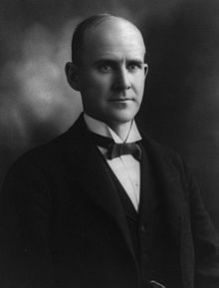
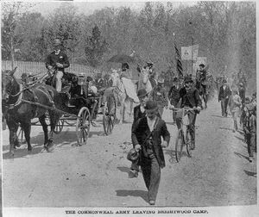
Key Concept 6.3, I
C) Alternative visions for the economy and US Society
Agrarians - sought more government involvement in economy (Populists), advocated government ownership of railroads
Coxey’s Army - marched to Washington, demanded relief
Utopians - Oneida Community - practiced communal ownership, free love, and eugenics
Socialists - Society is more than the individual, promotes human welfare, elimination of class systems
Social Gospel - Protestant Church movement to improve society

Slide 6
Key Concept 6.3, II
“Dramatic social changes in the period inspired political debates over citizenship, corruption, and the proper relationship between business and government.” - page 66
A) Republicans and Democrats in the late-19th century:
“Solid South” - voted Democratic
North - voted mostly Republican
Differences between two parties:
Tariffs - Republicans advocated raising tariffs, Democrats advocated lowering
Currency:
Election of 1896 - Republicans favored Gold Standard, Democrats favored Free Silver
Reformers argued that greed and self-interest corrupted all levels of government
Local levels - political machines
Federal level - patronage and election of senators by state legislatures

Slide 7

Key Concept 6.3, II
B) Women sought greater equality by:
Joining voluntary organizations: Women’s Christian Temperance Union (WCTU), National American Woman Suffrage Association (NAWSA)
NAWSA helped lead to the passage of the 19th amendment
Going to college: emergence of many women’s colleges - seminaries
Promoting social and political reform:
Elizabeth Cady Stanton - leading suffragist, advocate of interracial marriage
Working in settlement houses:
Jane Addams and the Hull House

Slide 8
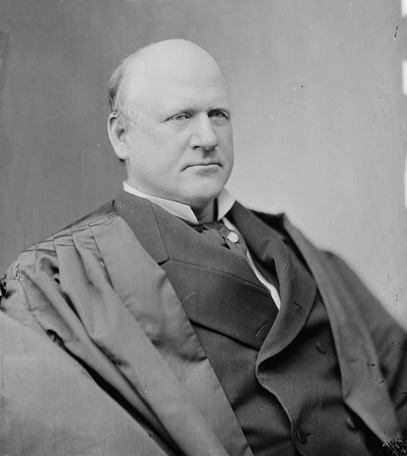
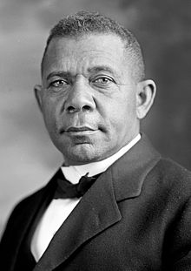
Key Concept 6.3, II
C) Plessy v. Ferguson (1896):
Upheld racial segregation - “separate but equal”
Most gains made by African Americans during Reconstruction were severely limited (13 - 15 amendments)
African American reformers continued to fight for political and social equality in the face of:
Violence - Ida B. Wells was a journalist that was an outspoken critic of lynching, advocating a federal anti-lynching law
Discrimination - Booker T. Washington - advocated vocational training for African Americans
Scientific theories of race - some anthropologists argued that African Americans were inferior to whites - use skull measurements

Slide 9
Test Tips
Multiple-Choice and Short Answer:
Plessy v. Ferguson - impacts
Alternatives to capitalism
Examples of discrimination and how people countered it
Essays:
Comparing forms of discrimination with other time periods
Responses of African Americans in 1890s-1920s and 1950s-1960s

Slide 10
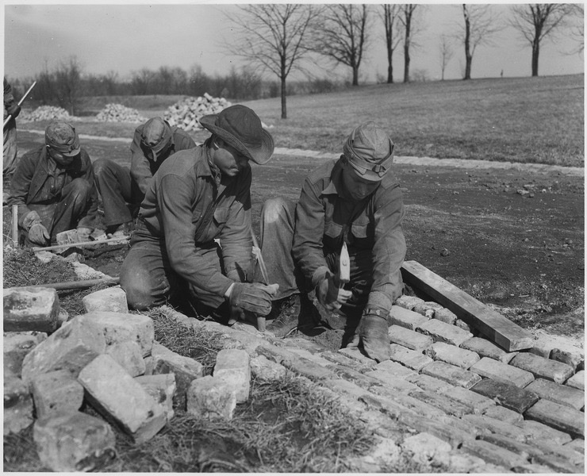
See You Back Here For 7.1
Thanks for watching
Best of luck in May!

